Slide 1




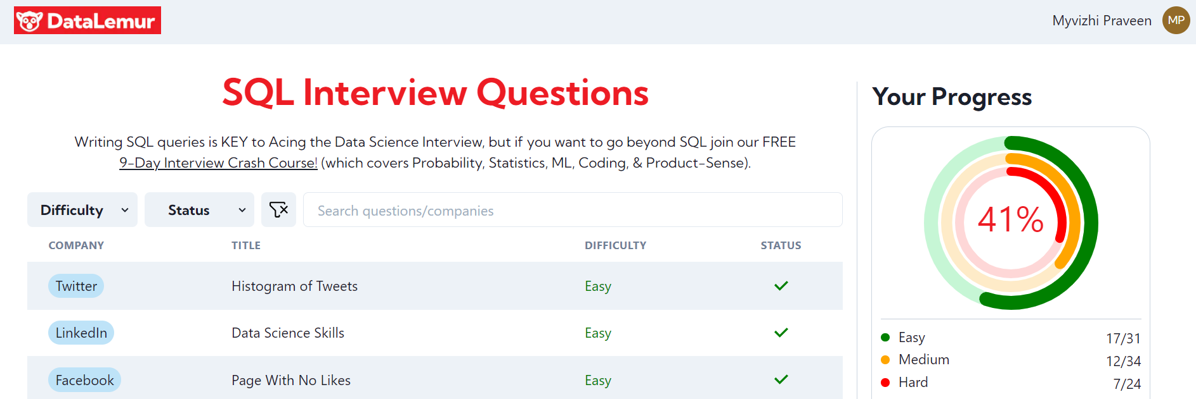
Myvizhi Praveen Kumar

Slide 2

SQL
Easy

Slide 3
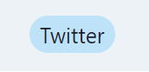
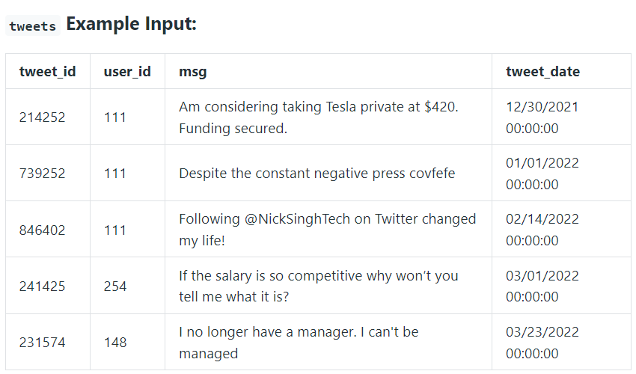
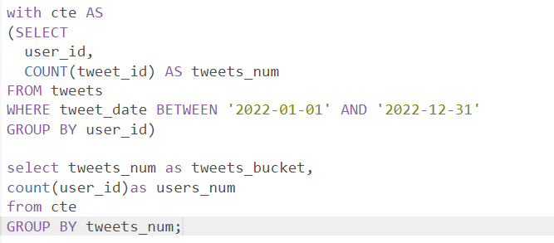
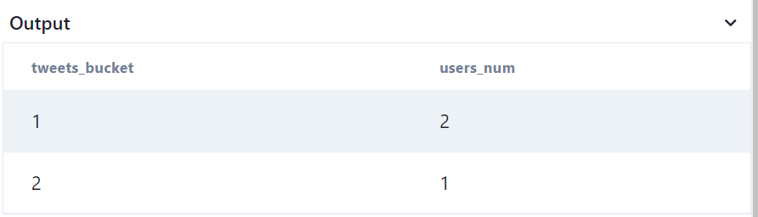
1. write a query to obtain a histogram of tweets posted per user in 2022. Output the tweet count per user as the bucket and the number of Twitter users who fall into that bucket.

Slide 4
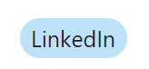
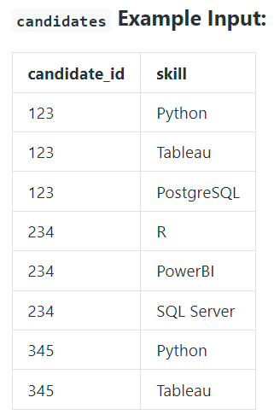
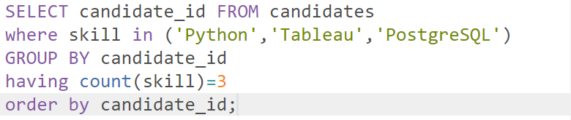
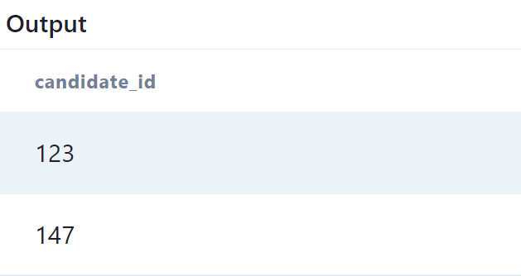
2. you're tasked with finding the candidates best suited for an open Data Science job. You want to find candidates who are proficient in Python, Tableau, and PostgreSQL. Write a query to list the candidates who possess all of the required skills for the job. Sort the output by candidate ID in ascending order.

Slide 5
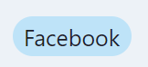
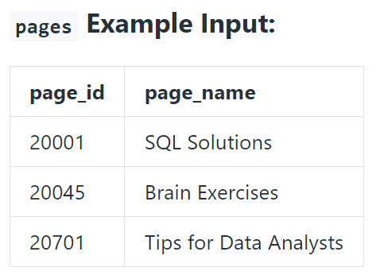
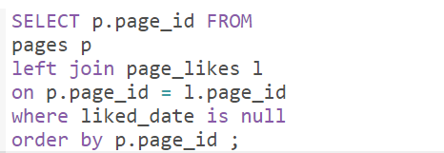
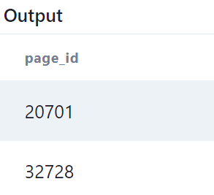
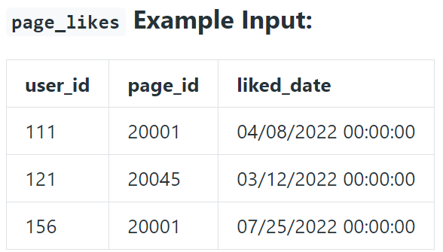
3. Assume you're given two tables containing data about Facebook Pages and their respective likes (as in "Like a Facebook Page"). Write a query to return the IDs of the Facebook pages that have zero likes. The output should be sorted in ascending order based on the page IDs.

Slide 6
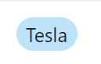
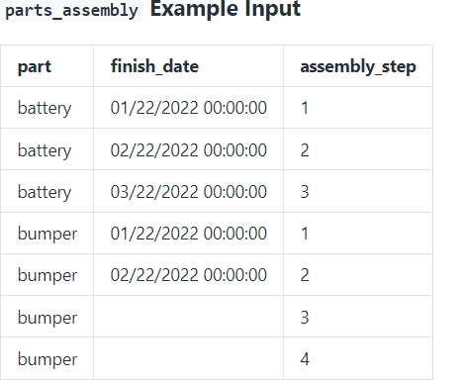
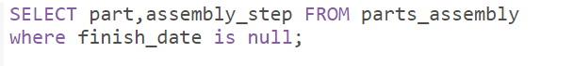
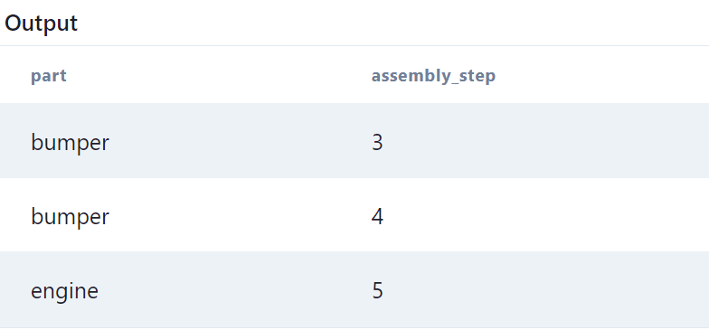
4. Tesla is investigating production bottlenecks, and they need your help to extract the relevant data. Write a query to determine which parts have begun the assembly process but are not yet finished.

Slide 7
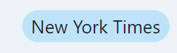
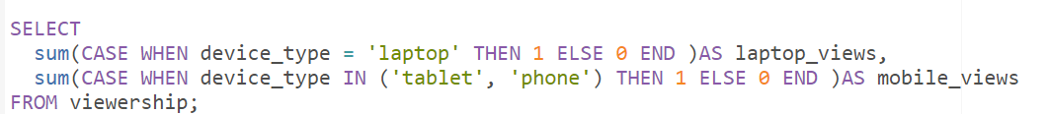
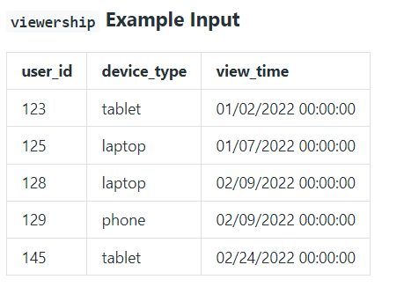
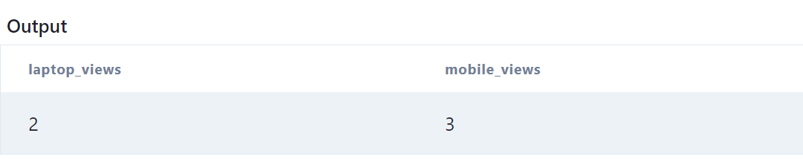
5. Write a query that calculates the total viewership for laptops and mobile devices
where mobile is defined as the sum of tablet and phone viewership.
Output the total viewership for laptops as laptop_reviews and the total viewership for mobile devices as mobile_views.

Slide 8
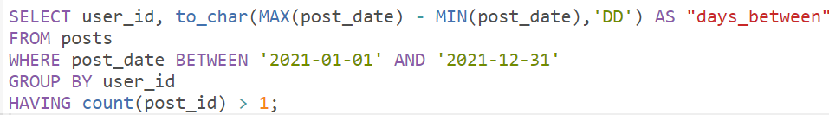
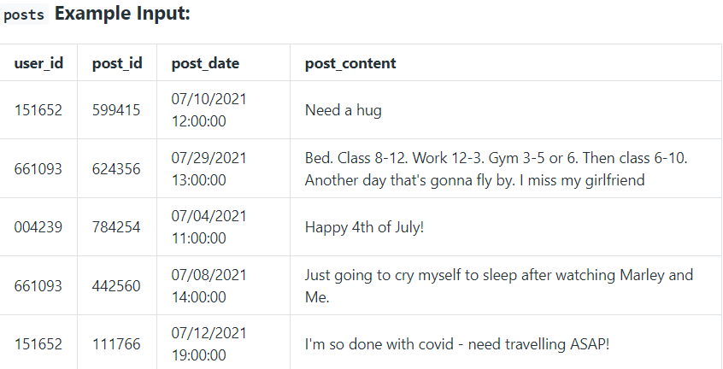
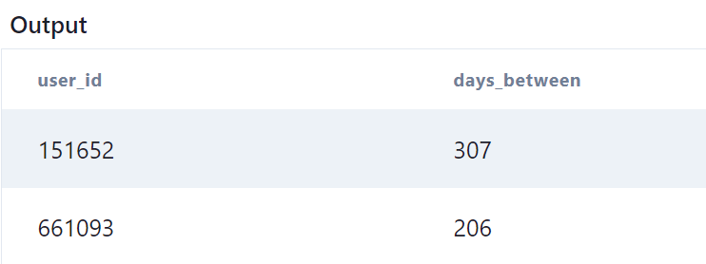
6. Given a table of Facebook posts, for each user who posted at least twice in 2021, write a query to find the number of days between each user’s first post of the year and last post of the year in the year 2021. Output the user and number of the days between each user's first and last post.

Slide 9
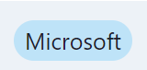
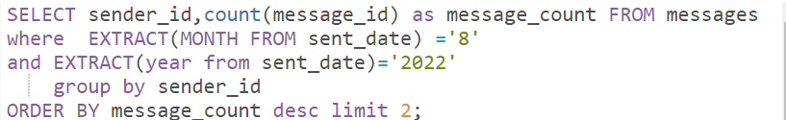
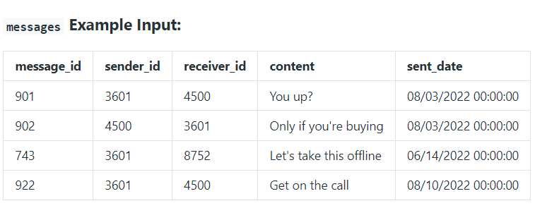
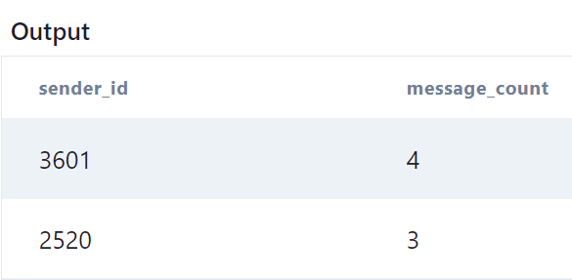
7. Write a query to identify the top 2 Power Users who sent the highest number of messages on Microsoft Teams in August 2022. Display the IDs of these 2 users along with the total number of messages they sent. Output the results in descending order based on the count of the messages.

Slide 10

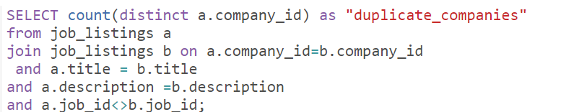
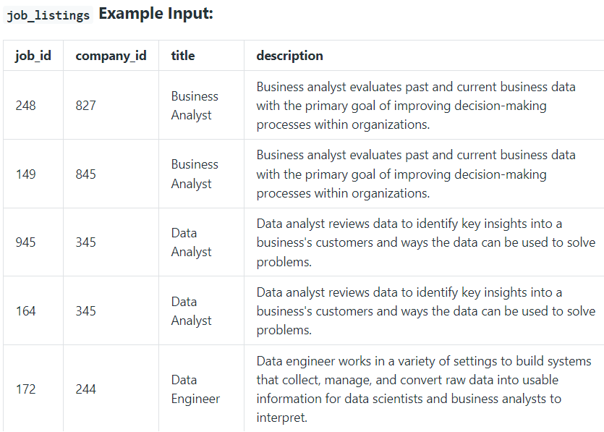
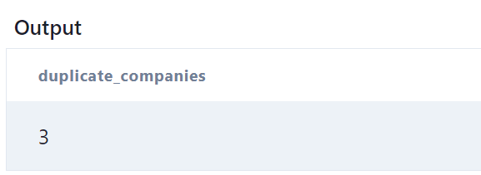
8. Assume you're given a table containing job postings from various companies on the LinkedIn platform. Write a query to retrieve the count of companies that have posted duplicate job listings.

Slide 11
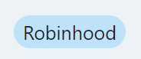
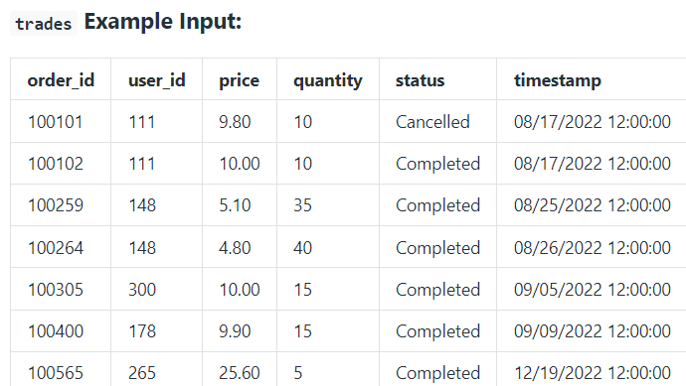
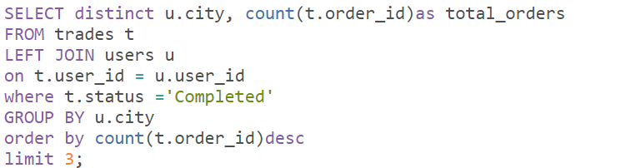
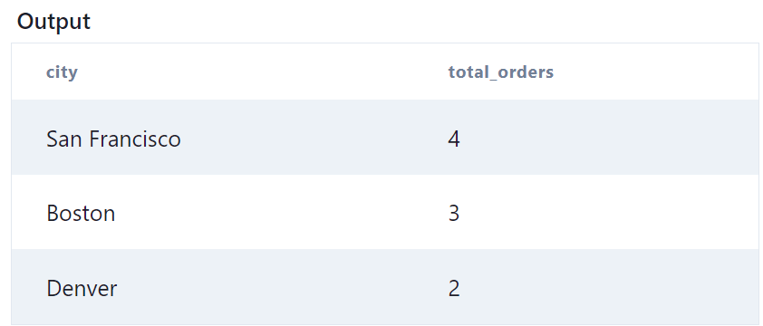
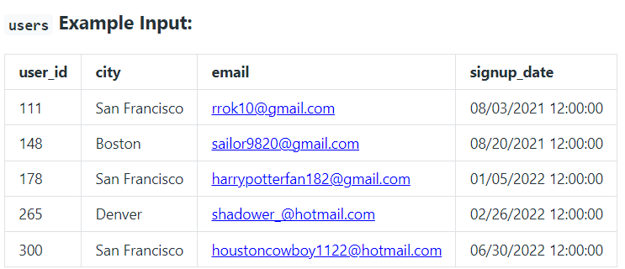
9. Write a query to retrieve the top three cities that have the highest number of completed trade orders listed in descending order. Output the city name and the corresponding number of completed trade orders.

Slide 12
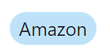
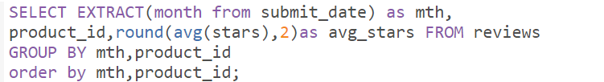
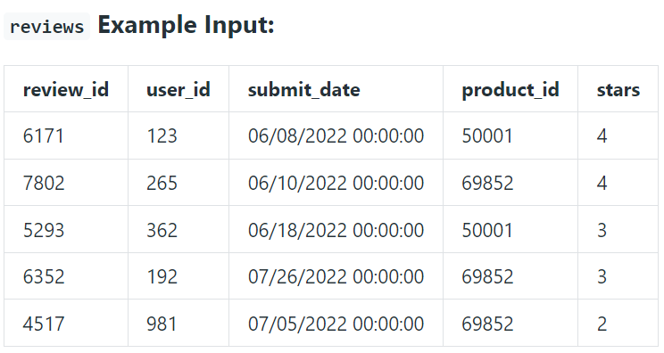
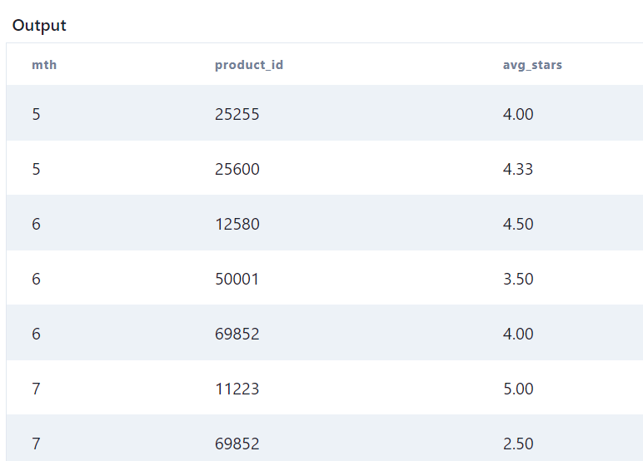
10. Given the reviews table, write a query to retrieve the average star rating for each product, grouped by month. The output should display the month as a numerical value, product ID, and average star rating rounded to two decimal places. Sort the output first by month and then by product ID.

Slide 13
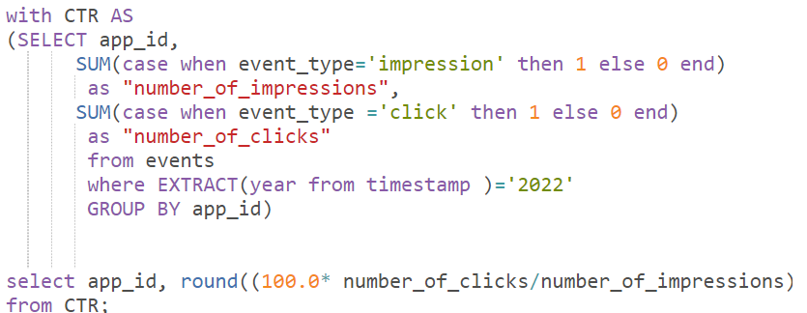
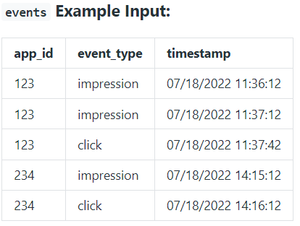
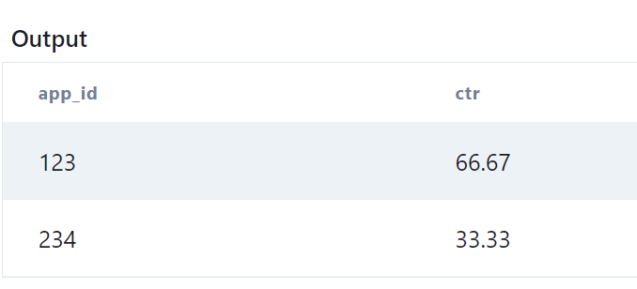
11. Assume you have an events table on Facebook app analytics. Write a query to calculate the click-through rate (CTR) for the app in 2022 and round the results to 2 decimal places.

Slide 14
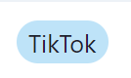
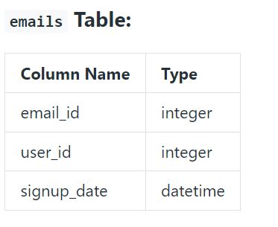
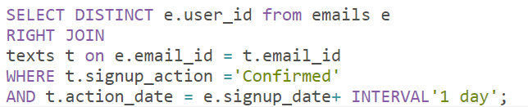
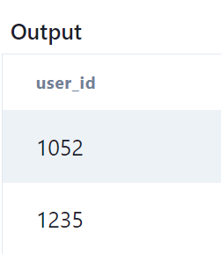
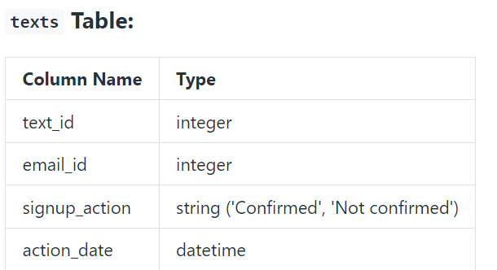
12. Assume you're given tables with information about TikTok user sign-ups and confirmations through email and text. New users on TikTok sign up using their email addresses, and upon sign-up, each user receives a text message confirmation to activate their account. Write a query to display the user IDs of those who did not confirm their sign-up on the first day but confirmed on the second day. Definition: action_date refers to the date when users activated their accounts and confirmed their sign-up through text messages.

Slide 15
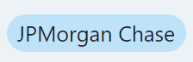



13. Your team at JPMorgan Chase is preparing to launch a new credit card, and to gain some insights, you’re analyzing how many credit cards were issued each month. Write a query that outputs the name of each credit card and the difference in the number of issued cards between the month with the highest issuance cards and the lowest issuance. Arrange the results based on the largest disparity.

Slide 16




14. You're trying to find the mean number of items per order on Alibaba, rounded to 1 decimal place using tables which includes information on the count of items in each order (item_count table) and the corresponding number of orders for each item count (order_occurrences table).

Slide 17




15. CVS Health is trying to better understand its pharmacy sales, and how well different products are selling. Each drug can only be produced by one manufacturer. Write a query to find the top 3 most profitable drugs sold, and how much profit they made. Assume that there are no ties in the profits. Display the result from the highest to the lowest total profit.

Slide 18



16. Write a query to identify the manufacturers associated with the drugs that resulted in losses for CVS Health and calculate the total amount of losses incurred. Output the manufacturer's name, the number of drugs associated with losses, and the total losses in absolute value. Display the results sorted in descending order with the highest losses displayed at the top.

Slide 19



17. Write a query to calculate the total drug sales for each manufacturer. Round the answer to the nearest million and report your results in descending order of total sales. In case of any duplicates, sort them alphabetically by the manufacturer name. Since this data will be displayed on a dashboard viewed by business stakeholders, please format your results as follows: "$36 million".

Slide 20
SQL
Intermediate

Slide 21




18. Assume you are given the table below on Uber transactions made by users. Write a query to obtain the third transaction of every user. Output the user id, spend and transaction date.

Slide 22



19. Write a query to obtain a breakdown of the time spent sending vs. opening snaps as a percentage of total time spent on these activities grouped by age group. Round the percentage to 2 decimal places in the output.

Slide 23


19. Write a query to obtain a breakdown of the time spent sending vs. opening snaps as a percentage of total time spent on these activities grouped by age group. Round the percentage to 2 decimal places in the output.

Slide 24




20. Given a table of tweet data over a specified time period, calculate the 3-day rolling average of tweets for each user. Output the user ID, tweet date, and rolling averages rounded to 2 decimal places. Notes:A rolling average, also known as a moving average or running mean is a time-series technique that examines trends in data over a specified period of time. Determine how the tweet count for each user changes over a 3-day period.

Slide 25




21. Assume you're given a table containing data on Amazon customers and their spending on products in different category, write a query to identify the top two highest-grossing products within each category in the year 2022. The output should include the category, product, and total spend.

Slide 26





22. Write a query to find the top 5 artists whose songs appear most frequently in the Top 10 of the global_song_rank table.
Display the top 5 artist names in ascending order, along with their song appearance ranking.
If two or the same number of song appearances,
they should be assigned the same ranking, and the rank numbers should be continuous (i.e. 1, 2, 2, 3, 4, 5).

Slide 27





23. New TikTok users sign up with their emails. They confirmed their signup by replying to the text confirmation to activate their accounts. Users may receive multiple text messages for account confirmation until they have confirmed their new account. A senior analyst is interested to know the activation rate of specified users in the emails table. Write a query to find the activation rate. Round the percentage to 2 decimal places.

Slide 28




24. A Microsoft Azure Supercloud customer is defined as a company that purchases at least one product from each product category. Write a query that effectively identifies the company ID of such Supercloud customers.

Slide 29




25. Assume you're given a table with measurement values obtained from a Google sensor over multiple days with measurements taken multiple times within each day. Write a query to calculate the sum of odd-numbered and even-numbered measurements separately for a particular day and display the results in two different columns.

Slide 30




26. Assume you're given a table on Walmart user transactions. Based on their most recent transaction date, write a query that retrieve the users along with the number of products they bought. Output the user's most recent transaction date, user ID, and the number of products, sorted in chronological order by the transaction date.

Slide 31




27. You're given a table containing the item count for each order on Alibaba, along with the frequency of orders that have the same item count. Write a query to retrieve the mode of the order occurrences. Additionally, if there are multiple item counts with the same mode, the results should be sorted in ascending order.

Slide 32




28. Write a query that outputs the name of the credit card, and how many cards were issued in its launch month.
The launch month is the earliest record in the monthly_cards_issued table for a given card. Order the results starting from the biggest issued amount.

Slide 33





29. What percentage of phone calls are international? Round the result to 1 decimal.
Assumption: The caller_id in phone_info table refers to both the caller and receiver.

Slide 34
SQL
Hard

Slide 35




30. Assume you're given a table containing information on Facebook user actions. Write a query to obtain number of monthly active users (MAUs) in July 2022, including the month in numerical format "1, 2, 3". Hint: An active user is defined as a user who has performed actions such as 'sign-in', 'like', or 'comment' in both the current month and the previous month.

Slide 36




31. Assume you're given a table containing information about Wayfair user transactions for different products. Write a query to calculate the year-on-year growth rate for the total spend of each product, grouping the results by product ID. The output should include the year in ascending order, product ID, current year's spend, previous year's spend and year-on-year growth percentage, rounded to 2 decimal places.

Slide 37



32. Amazon wants to maximize the number of items it can stock in a 500,000 square feet warehouse.
It wants to stock as many prime items as possible, and afterwards use the remaining square footage to stock the most number of non-prime items.
Write a query to find the number of prime and non-prime items that can be stored in the 500,000 square feet warehouse.
Output the item type with prime_eligible followed by not_prime and the maximum number of items that can be stocked.

Slide 38




33. Google's marketing team is making a Superbowl commercial and needs a simple statistic to put on their TV ad: the median number of searches a person made last year. However, at Google scale, querying the 2 trillion searches is too costly. Luckily, you have access to the summary table which tells you the number of searches made last year and how many Google users fall into that bucket. Write a query to report the median of searches made by a user. Round the median to one decimal point.

Slide 39


34. You're provided with two tables: the advertiser table contains information about advertisers and their respective payment status, and the daily_pay table
Contains the current payment information for advertisers, and it only includes advertisers who have made payments.
Write a query to update the payment status of Facebook advertisers based on the information in the daily_pay table.
The output should include the user ID and their current payment status, sorted by the user id.
The payment status of advertisers can be classified into the following categories:
New: Advertisers who are newly registered and have made their first payment.
Existing: Advertisers who have made payments in the past and have recently made a current payment.
Churn: Advertisers who have made payments in the past but have not made any recent payment.
Resurrect: Advertisers who have not made a recent payment but may have made a previous payment and have made a payment again recently.

Slide 40



Slide 41



36. Amazon Web Services (AWS) is powered by fleets of servers. Senior management has requested data-driven solutions to optimize server usage.
Write a query that calculates the total time that the fleet of servers was running. The output should be in units of full days.
Assumptions:
Each server might start and stop several times.
The total time in which the server fleet is running can be calculated as the sum of each server's uptime.

Slide 42
Thank You

